Slide 1
Economics 144 Economic Forecasting
Lecture 1
Economic Forecasting: The Basics
Dr. Randall R. Rojas

Slide 2
Today’s Class 1 of 2
Overview of the course structure and content
Why Study Economic Forecasting?
Resources
Overview of Economic Forecasting
Six Fundamental Considerations in Forecasting
Decision Environment
Forecast Object
Forecast Statement
Forecast Horizon
Information Set
Parsimony Principle and Shrinkage Principle
Background on “R”

Slide 3
Today’s Class 2 of 2
Note: This brief review is included for reference and we will not discuss it in class.
A Gentle Review of Probability, Statistics, and Regression
RVs, Distributions, and Moments
Multivariate RVs
Statistics
Regression

Slide 4
Course Content
Forecasting Trend
Forecasting Seasonality
Forecasting Cycles
Forecasting with Regression Models
Combining Forecasts
Advanced Methods (e.g., ARIMA, GARCH, etc.)

Slide 5
Useful References
Books:
Applied Econometric Time Series, 3rd Ed., W. Enders (Easy)
A Companion to Economic Forecasting. M. P. Clements and D. F. Hendry (Medium)
Time Series Analysis. J. D. Hamilton (Difficult)
Time Series Applications to Finance with R and S-Plus, 2nd Ed., N.G. Chan (includes R codes)
Analysis of Financial Time Series, 3rd Ed. Ruey S. Tsay (includes R codes)
http://faculty.chicagobooth.edu/ruey.tsay/teaching/ →teaching→Business 41202
Time Series Analysis and its Applications with R Examples, 3rd Ed. Robert H. Shumway & David S. Stoffer (includes R codes)
Journals:
Journal of Forecasting
International Journal of Forecasting
Journal of Business and Forecasting
Journal of Business and Economic Statistics
Review of Economics and Statistics
Journal of Applied Econometrics
Online information:
Resources for Economists (www.rfe.org)
Economagic (http://www.economagic.com)

Slide 6
Why Study Economic Forecasting?
Quote from “The International Review of Economics Education”.
…Departments have several compelling reasons to add a forecasting class to their curriculum.
First, forecasting is an important process in most businesses and therefore an important skill to possess as an employee.
Second, the demand for professional forecasters is growing, so future graduates will readily find jobs available in this area.
Third, a forecasting course complements other quantitative methods courses by providing a more in-depth study of data preparation, information appraisal, empirical judgment and process management.
Finally, a forecasting course bridges the gap between theoretical models or abstract statistics and real-world applications by providing a corporate context in which these models and statistics are used.”

Slide 7
Overview of Economic Forecasting _{1 of 2}
Q1: What is a forecast?
Ans: A forecast is a statement about the future.
Note: Forecasting = the science and the art to predict a future event with some degree of accuracy.
Q2: How is forecasting done by economists?
Ans: In economics, methods of forecasting include:
Guessing, “rules of thumb”, or “informal models”
Expert judgment
Extrapolation
Leading indicators
Surveys
Time Series models
Econometric systems

Slide 8
Overview of Economic Forecasting _{2 of 2}
Q3: What are the main problems?
Ans: One of the main problems with forecasting in economics is that economies evolve over time and are subject to intermittent, and sometimes large, unanticipated shocks.
Q4: What are some relevant forecast examples?
Ans: Some of the relevant areas include:
Operations planning and control
Marketing
Economics
Financial asset management
Financial risk management
Demography
Crisis management

Slide 9
Standard Notation
Description | Technical name | Notation
Object to analyze: | Time series
Value at present time t : | Known value of the series
Future at time t+h: | Random variable
Value at future time t+h: | Unknown value of the random variable
Collection of information : | Univariate information set Multivariate information set
Final objective: | Forecast 1-step ahead h-step ahead
Uncertainty: | Forecast error

Slide 10
Six Fundamental Considerations in Forecasting The Forecast Object _{1 of 1}
Event Outcome Forecasts: Event is certain, outcome is unknown, timing known.
Event Timing Forecasts: Event is certain, outcome is known, timing unknown.
Time Series Forecasts: Project the future value of a time series. (most commonly encountered)
Event outcome
Event timing
Time Series
Forecast Object

Slide 11
Six Fundamental Considerations in Forecasting The Forecast Statement _{1 of 2}
What will the forecast result be?
Point Forecast: Single number (e.g., μ).
Interval Forecast: Range of values. (~confidence interval, e.g., μ ± z*σ).
Density Forecast: Probability Distribution of the of the future value of the series (e.g., N(μ, σ² )).
Most common!
less information
more information

Slide 12
Six Fundamental Considerations in Forecasting The Forecast Statement _{2 of 2}
Probability Density
Density Forecast
5%
5%
GDP Growth
-2.3%
1.3
Point Forecast
4.3%
90% Interval Forecast

Slide 13
Six Fundamental Considerations in Forecasting The Forecast Statement _{2 of 2}
Interval forecast
Density forecast
Conditional probability
density function of
.
.
.
.
Point forecast
0
1
2
……………..
t
t+h
time
Information set

Slide 14
Six Fundamental Considerations in Forecasting The Forecast Horizon _{1 of 2}
Forecast Horizon: Number of periods between today and the end date of the forecast.
In general: h-step-ahead forecast (where h is the step length). The horizon is fixed (h is constant).
h-step-ahead extrapolation forecast: Includes all steps from 1-step-ahead to : h-steps-ahead.
Example: Today: Year =T
→Forecast GDP for year T+5→Forecast horizon of 5 steps.

Slide 15
Six Fundamental Considerations in Forecasting The Forecast Horizon _{2 of 2}
Series or Forecast
In-sample historical data
Out-of-sample forecast
*
*
*
*
4-Step-Ahead Extrapolation Point Forecast
Time
1 2 … T-1 T T+1 T+2 T+3 T+4
4-Step-Ahead-Point Forecast

Slide 16
Six Fundamental Considerations in Forecasting The Information Set _{1 of 1}
Your forecast is conditional on the quality and quantity of your data.
Questions:
What information is available?
What else could be collected? Or made available?
Quantitative or Qualitative?
Can the data be used more efficiently?
Univariate Information Set:
Ω_{T}^{univariate}={y_{T} , y_{T-1} ,…,y₁}
Multivariate Information Set:
Ω_{T}^{multivariate}={x_{T} , y_{T,} , x_{T-1}, y_{T-1} …, x_{1,} y₁}

Slide 17
Six Fundamental Considerations in Forecasting Models and Complexity, The Parsimony and Shrinkage Principles _{1 of 1}
Your modeling strategy should be based on your forecast task.
For out-of-sample forecasting in business, finance, and economics, simple (parsimonious) models are better.
Parsimony Principle: All other things being equal, simpler models are better than complex ones.
Shrinkage Principle: Imposing restrictions on forecasting models often improves forecast performance.
KISS Principle: Keep It Sophisticatedly Simple

Slide 18
Example: Trends Annual Hours Worked in the OECD Countries 1979-2006
Source: http://www.oecd.org

Slide 19
Example: Cycles Unemployed Persons (Seasonally Adjusted), Monthly Data 1988-2008
Source: St. Louis Federal Reserve Bank. FRED

Slide 20
Example: Seasonality Revenue Passenger Enplanements. Monthly Data 2000-2008
Peaks occur regularly around July
Source: Bureau of Transportation Statistics

Slide 21
Example: Combined New Home Sales in the United States. Quarterly Data 2004-2008
Source: National Association of Realtors

Slide 22
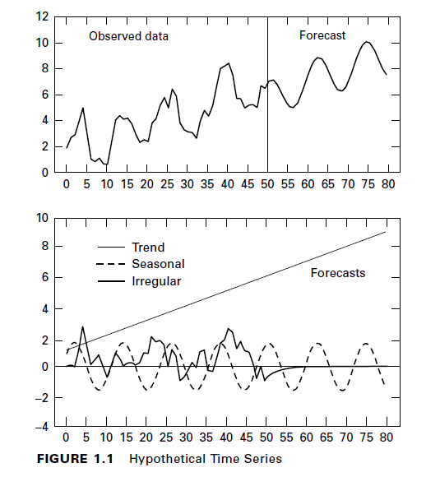
Example: Combined Hypothetical Time Series
T_{t} = Value of the trend component in period t
S_{t} = Value of the seasonal component in period t
I_{t} = Value of the irregular component in period t
𝜀_{t} = a pure random disturbance in period t
(T_{t} )
(S_{t} )
(I_{t} )
T_{t} = 1 + 0.1t
S_{t} = 1.6 sin(πt/6)
I_{t} = 0.7 I_{t-1} + 𝜀_{t}

Slide 23
Model Building Strategy
Q: How to find an appropriate model for a Time Series?
A: There are 3 steps
Model Specification (or identification)
Select the types of plausible models given the data (time plot)
Model Fitting
Follow the parsimony principle
Model Diagnostics
Assess the quality of the model

Slide 24
Introduction to Time Series Data 1 of 3
Q1: What is a stochastic process and what is a time series?
Q2: What is the interpretation of a time average or any other time moment?
Q3: What are the new tools of analysis?

Slide 25
A Gentle Review of Probability, Statistics, and Regression
I. RVs, Distributions, and Moments
II. Multivariate RVs
III. Statistics
IV. Regression Analysis

Slide 26
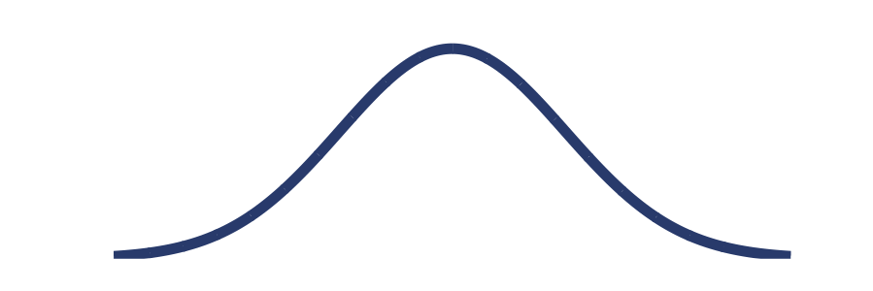
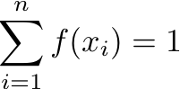
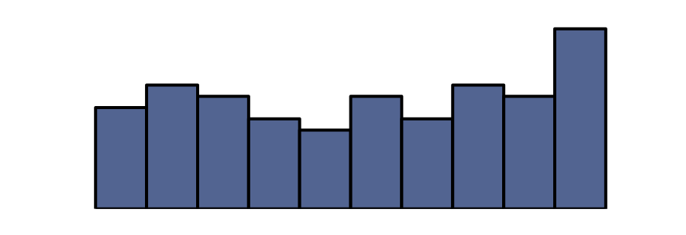
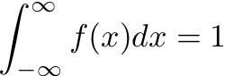
I. Random Variables, Distributions and Moments _{1 of 5}
Random Variables
Discrete
→Probability Mass Function (pmf)
Continuous
→Probability Density Function (pdf)
pmf
f(x)
pdf
f(x)
x
x

Slide 27
I. Random Variables, Distributions and Moments _{2 of 5}
Random Variables (RVs): Represent the outcomes from random phenomena.
Discrete RVs: Take on only a countable number of distinct values.
Probability Mass Function (pmf): Assigns probabilities to the outcomes associated with discrete random variables. →pmf=P(X=x) = f(x)
Continuous RVs: Take on an infinite number of possible values.
Probability Density Function (pdf): Assigns probabilities to the outcomes associated with discrete random variables. →pdf=f(x)

Slide 28
I. Random Variables, Distributions and Moments _{3 of 5}
Example 1: Discrete Probability Distribution
Flip a coin twice. Let X = number of heads.
4 possible outcomes
T
T
→ Sample Space: Ω={HH, HT, TH, TT}
x (value) | Probability: P(X=x) = f(x)
0 | 1/4 =0.25
1 | 2/4=0.50
2 | 1/4=0.25
T
H
H
T
f(x)
H
H
0.50
0.25
0.00
x

Slide 29
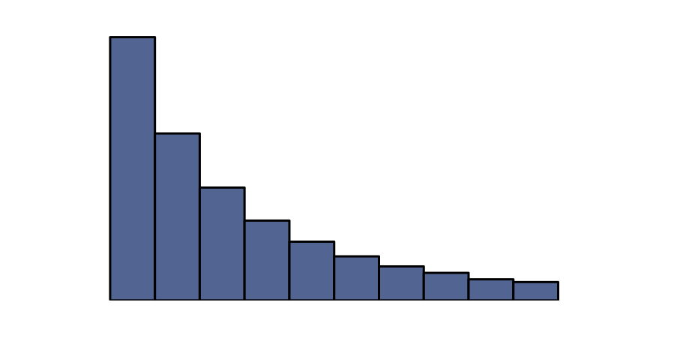
I. Random Variables, Distributions and Moments _{4 of 5}
K = Kurtosis (peakedness)
f(x)
μ = Mean or Expected Value (central tendency)
σ = Standard Deviation (spread around the mean)
S = Skewness (lopsidedness)
x
Moments of a Distribution

Slide 30
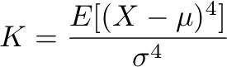
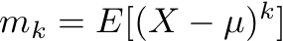
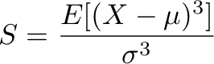
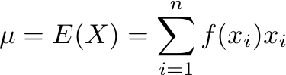
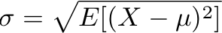
I. Random Variables, Distributions and Moments _{5 of 5}
Moments: Describe the shape of the distribution*.
Mean: Measures the central tendency of X.
Variance: Measures the dispersion around μ
Standard Deviation: Measured the spread around μ.
Skewness: Measure the lopsidedness (symmetry) of the distribution.
Kurtosis: Measure of whether the distribution is tall and skinny or short and squat.
*With respect to the normal distribution.

Slide 31
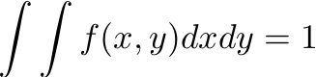
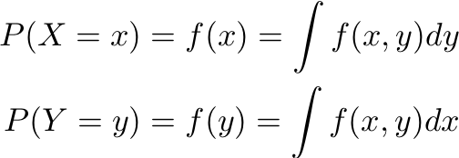
II. Multivariate Random Variables _{1 of 3}
Joint Distribution: P(X=x, Y=y) =f(x,y)
z
z =f(x,y)
Marginal Distribution of X
y
z
x
x
Marginal Distribution of Y
(Normalization)
y

Slide 32
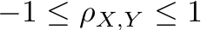
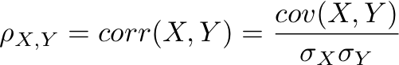
II. Multivariate Random Variables _{2 of 3}
Covariance: Is a measure of how much two* random variables change together.
Correlation: Is a measure of the relation between two random variables.
(Does not have units)
where
*There can be more than two random variables.

Slide 33
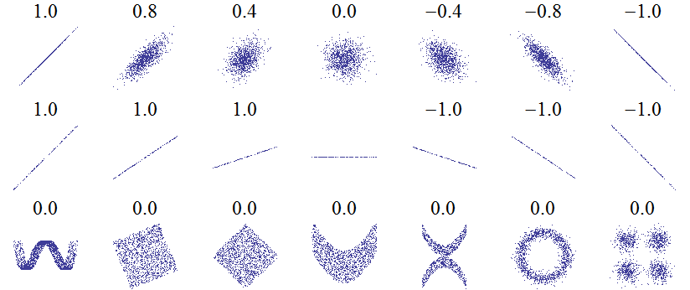
II. Multivariate Random Variables _{3 of 3}
Examples of Correlations between Two Random Variables
Strongly correlated* (ρ _{X,Y} =±1)
Weakly correlated.
Covariance and correlation measure only linear dependence.

Slide 34
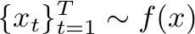
III. Statistics ₁ _{of 2}
In practice (quite often) we have a sample of data from un unknown distribution f.
Compute the sample
moments via estimators.
Sample of data
(have)
Unknown distribution
(want)
73 | 70 | 92 | • •• | 68
(sample mean)
Grades
(sample standard deviation)

Slide 35
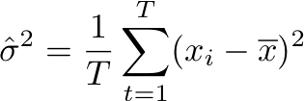
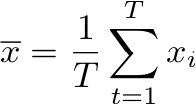
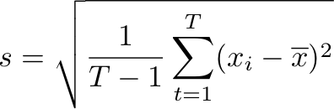
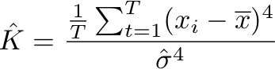
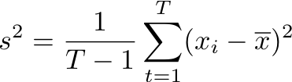
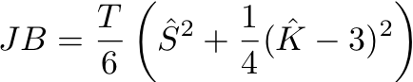
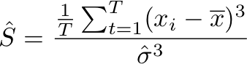
III. Statistics ₂ _{of 2}
Sample Mean:
Sample Variance:
Sample Standard Deviation:
Sample Skewness:
Sample Kurtosis:
Jarque-Bera Test:
where
Used to test for normality (S=0, K=3) of a distribution.

Slide 36
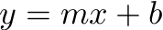
IV. Regression ₁ _{of 9}
Scatterplot of y vs x
Regression Line
y
observed (y)
e_{t}
fitted (ŷ)
x

Slide 37
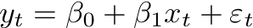
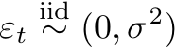
IV. Regression ₂ _{of 9}
Residuals (e_{t}): difference between the observed and predicted value →e_{t}= y_{t}-ŷ_{t}
Least Squares Line: Is the best fit line such that
Σ (residuals)² is minimized.
Linear Regression Model: Model that describes the data (for the linear case).
data = linear part + noise

Slide 38
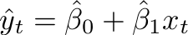
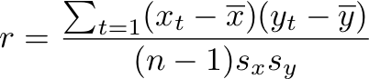
IV. Regression ₃ _{of 9}
Fitted Values (ŷ_{t}): in-sample forecasts
Data [y] = Model[ŷ_{t}] + Residuals[e_{t}]
Correlation coefficient:
,
Perfect correlation→r = ±1
r >0
r <0
r =0

Slide 39
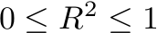
IV. Regression ₄ _{of 9}
Coefficient of Determination (R² or r²): Fraction of the data’s variation accounted for by the model.
Example: R² =0.80
Data [y] = Model[ŷ_{t}] + Residuals[e_{t}]
100% = 80% + 20%
Residuals: If the linear model is a good model for the data, there should be no structure in the plot of the residuals vs. x (or vs. ŷ). It should look like random points.
Perfect model→R² = 1 where

Slide 40
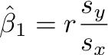
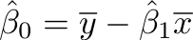
IV. Regression ₅ _{of 9}
Least Squares Line:
Slope:
Intercept:
The LS line goes through the centroid of the data.

Slide 41

IV. Regression ₆ _{of 9}
Example (Raw Data):
Year Revenue($M) Expenses($M) Income($M) Share ($M)
2000 19889.00 8551.00 2177.00 20834.00
2001 20092.00 8696.00 3969.00 22417.00
2002 19564.00 7001.00 3050.00 11800.00
2003 20857.00 7287.00 4347.00 14090.00
2004 21742.00 7890.00 4847.00 15935.00
2005 23104.00 8739.00 4872.00 16355.00
2006 24088.00 9431.00 5080.00 16920.00
2007 28857.00 10945.00 5981.00 21744.00
2008 31944.00 11774.00 5874.00 20472.00
2009 30990.00 11358.00 6906.00 24799.00
2010 35119.00 13158.00 11859.00 31003.00

Slide 42
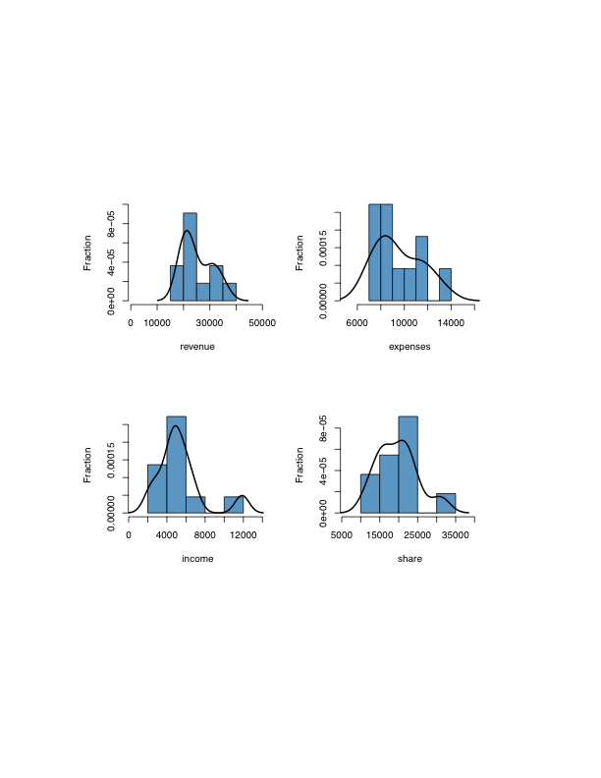
IV. Regression ₇ _{of 9}
Example (Distributions):
Revenue ($M)
Expenses ($M)
Income ($M)
Share ($M)

Slide 43
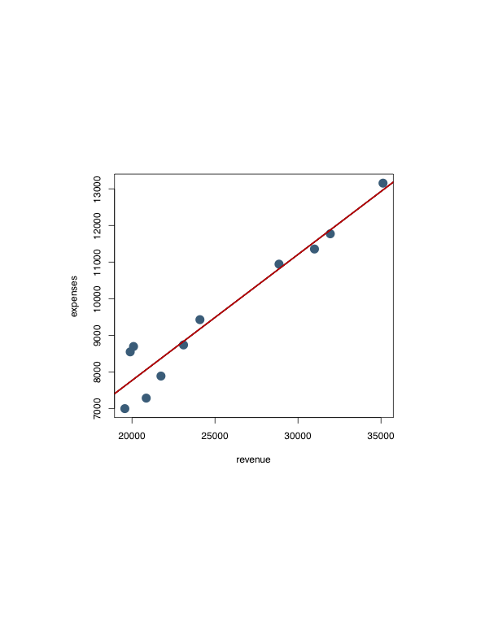
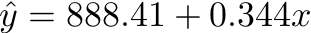
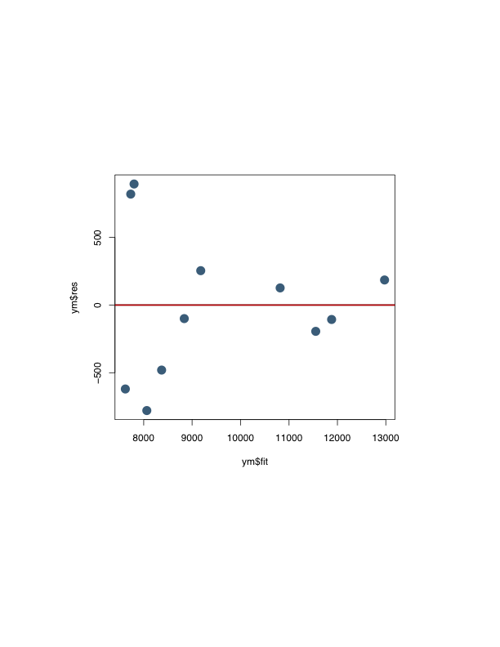
IV. Regression ₈ _{of 9}
Expenses
Residuals
Revenue
Fitted
Q: Does the linear regression model seems to work well for these data?
Yes!

Slide 44
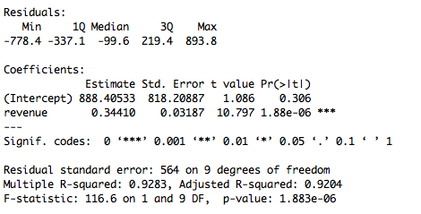
IV. Regression ₉ _{of 9}
Tests one variable at a time.
Tests all variables together.
(Model)

Slide 45
Background on R ₁ _{of 3}
R commands to do the regression model:
z0=read.table("data.txt", header = TRUE)
ym=lm(expenses~revenue)
summary(ym)
Read in the data
Compute the LS fit
Show results
R is a very powerful language for data mining large (and small) data sets. There are numerous built in functions for almost any application of interest. In addition, it easy to build your own functions to meet your specific computing needs. Currently it is one of the most widely used software across many fields, and knowing how to use it is in very high demand!

Slide 46
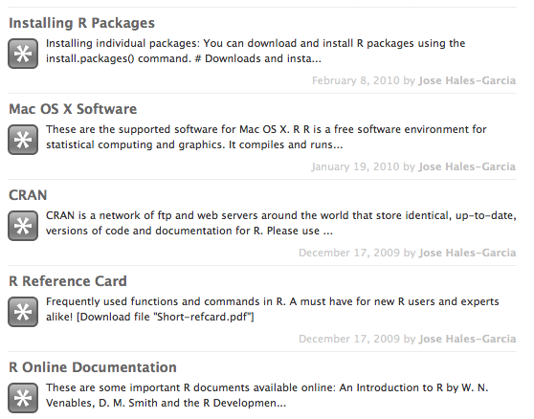
Background on R ₂ _{of 4}
Step 1 (Download R):
http://cran.stat.ucla.edu/
Step 2 (Install all packages):
install.packages(available.packages()[,1])
Step 3 (Try it out!):
http://answers.stat.ucla.edu/groups/answers/search/?q=R&tag=r

Slide 47

Background on R ₃ _{of 3}
R Session Demonstration

Slide 48
For Next Class
Readings about today’s class:
Chapters 1ª, 2ª, 1^{b}, 2^{b}, 3^{b}
For next class:
Download, install and have fun with R (try to repeat the regression example from today’s class)
Readings for next class:
Chapters 3ª, 4ª, 4^{b}

